Slide 1
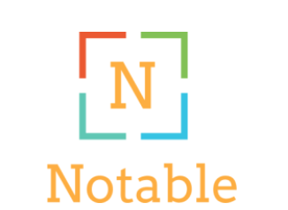
Indya Dodson, Lukas Fuller, and Alexander Meadows
(Michelle Mendoza)

Slide 2
Target Users
Various levels of experience with note taking apps
College students
17-24 years old
Intermediate to advanced experience with computers/mobile devices
Males and Females
Motivated to better understand course content and eventually improve grades.

Slide 3
Data Gathering Techniques
We interviewed 6 different students, on and off campus, with open ended unbiased questions to try and retrieve as much information as possible. Some of the questions included:
What level of experience do you have with note taking apps if any?
Would a note taking app be helpful or unhelpful to you as a student? Explain your answer.
If it would be helpful, what features would you like it to have?
If it would be unhelpful, why?

Slide 4
Requirements
We combined the most popular requirements from our users and determined which requirements could reasonably be implemented into the app. Here are some of the requirements:
Easy to use (user friendly)
Option to set up questions with the definitions and terms
Option to use flashcards for studying
Organization with folders
Review section to view content that the user still needs to work on more
Track progress of your understanding while you study

Slide 5
User Scenario
A student needs to take notes for an upcoming exam during his class
Opens the note taking app on his phone
Selects notes and begins to jot down information
Class ends, saves his progress to the server
Later he uses his notes to create flashcards
He reviews flashcards before the exam
He scores the highest grade in his class
Notes:
Johnny is in class and needs to take notes for an upcoming exam. He opens up his note taking app and the homepage screen is displayed. Johnny clicks on the take notes section of the app. This takes him to the editing notes screen, where he is able to input text with his keyboard or use a stylus to draw on the screen. Johnny listens to the professor’s lecture and types the notes into the app. He can add bullet points and highlight the text he thinks is important. Class ends and he taps the save button on the editing notes screen. The saving notes screen appears and Johnny names his notes document and chooses a location to save it to and then hits save.

Slide 6
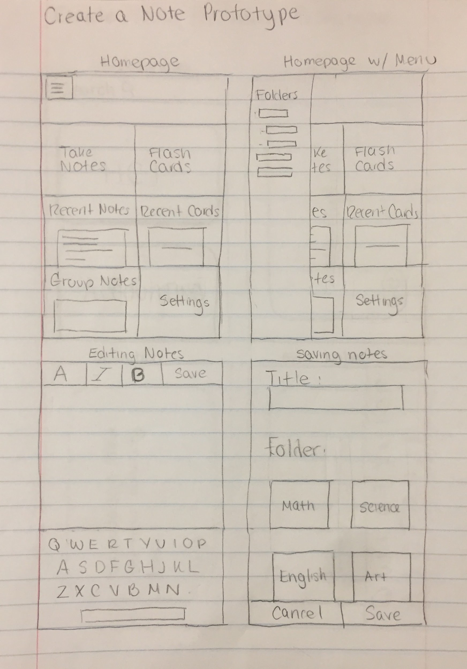
Low Fidelity Prototypes
First draft of the homepage, editing notes screen, and folder layout

Slide 7
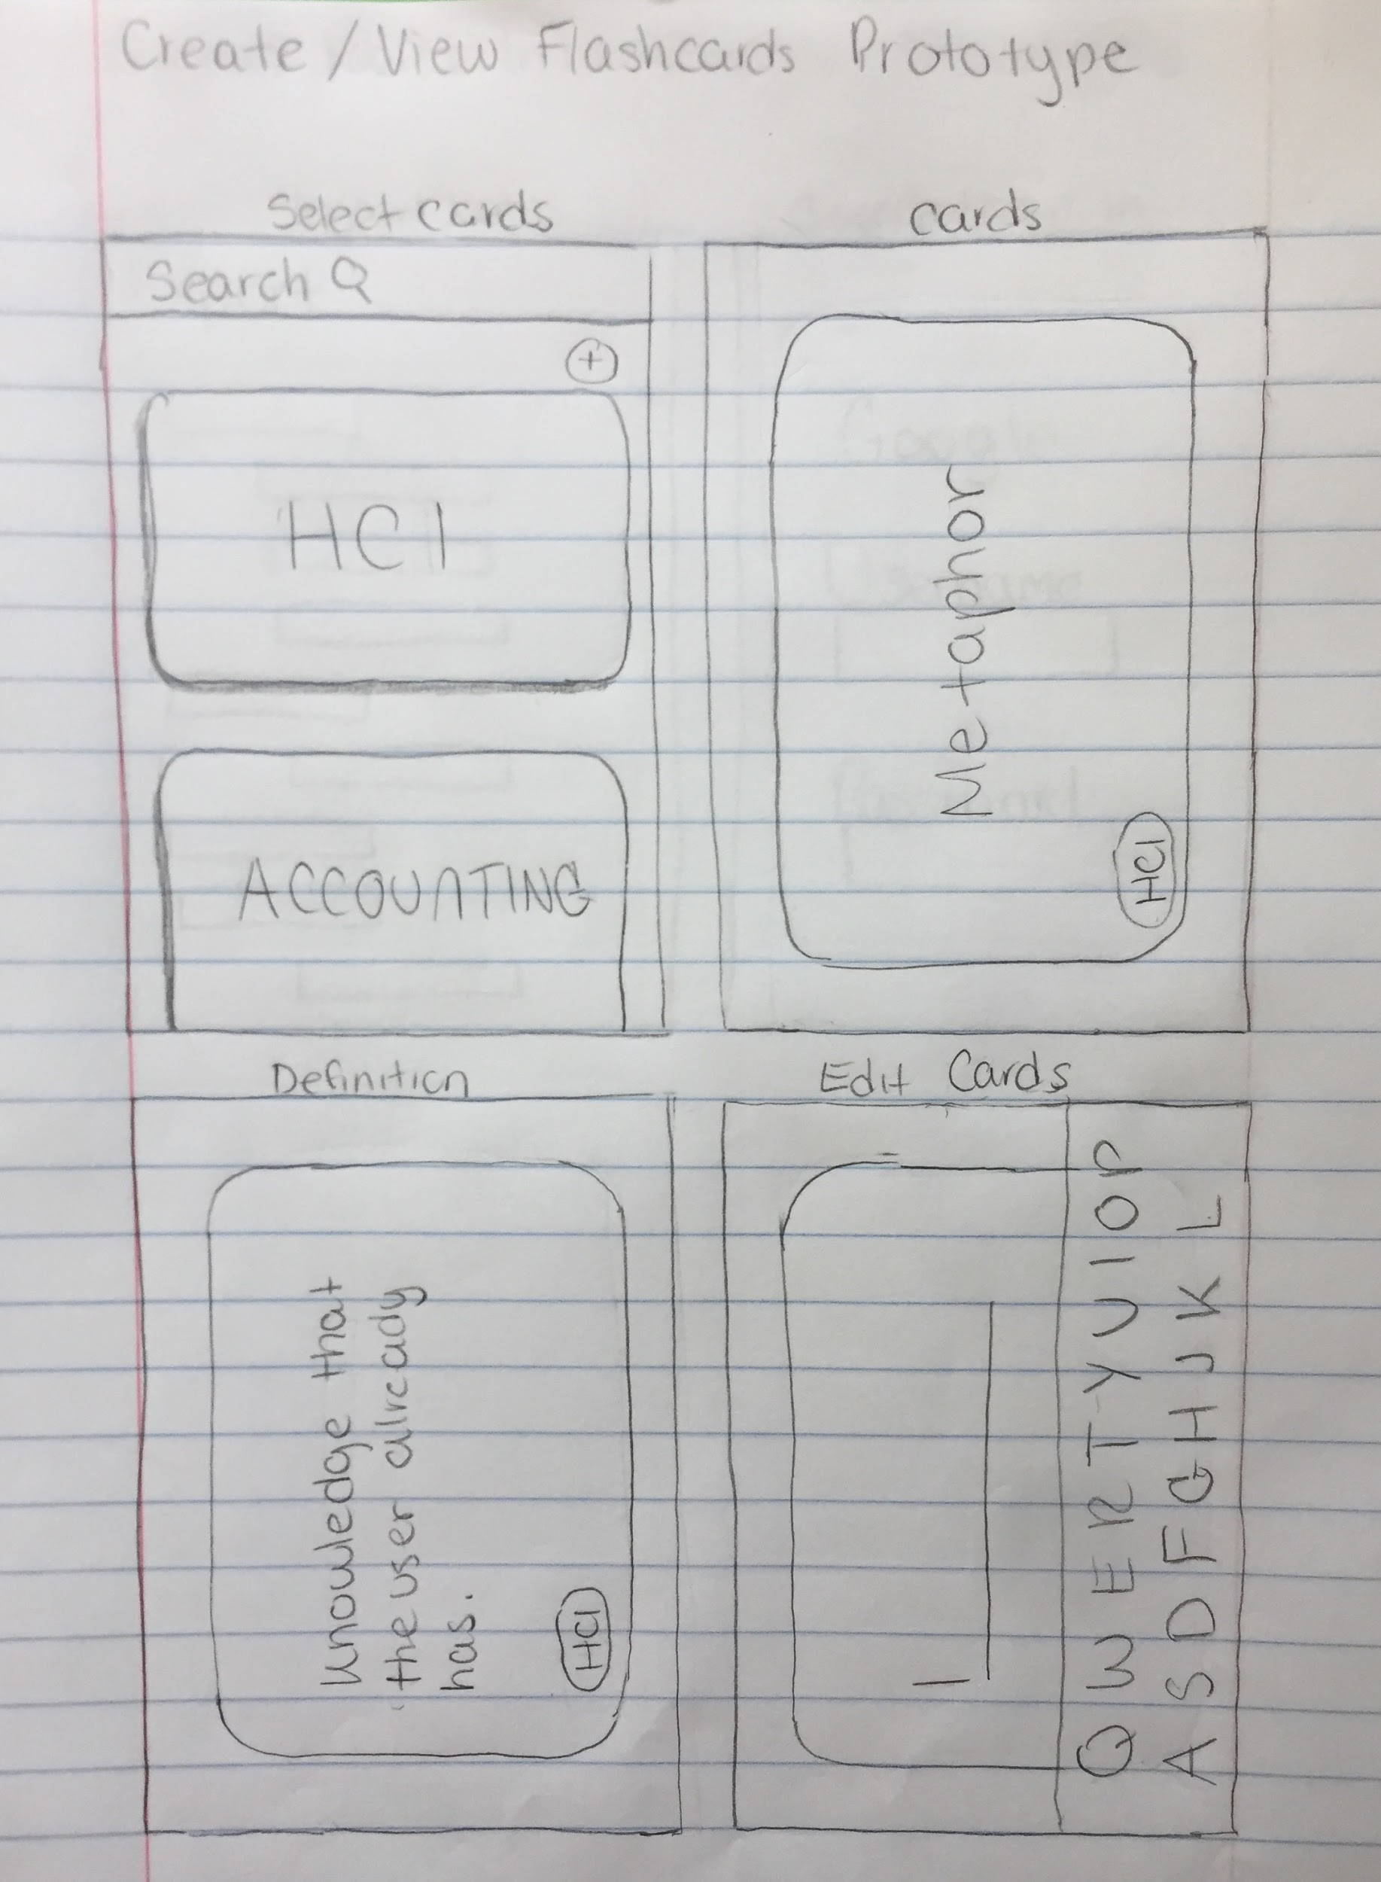
Low Fidelity Prototypes
(cont.)
Draft of the flashcard page, viewing flashcards, and editing flashcards

Slide 8
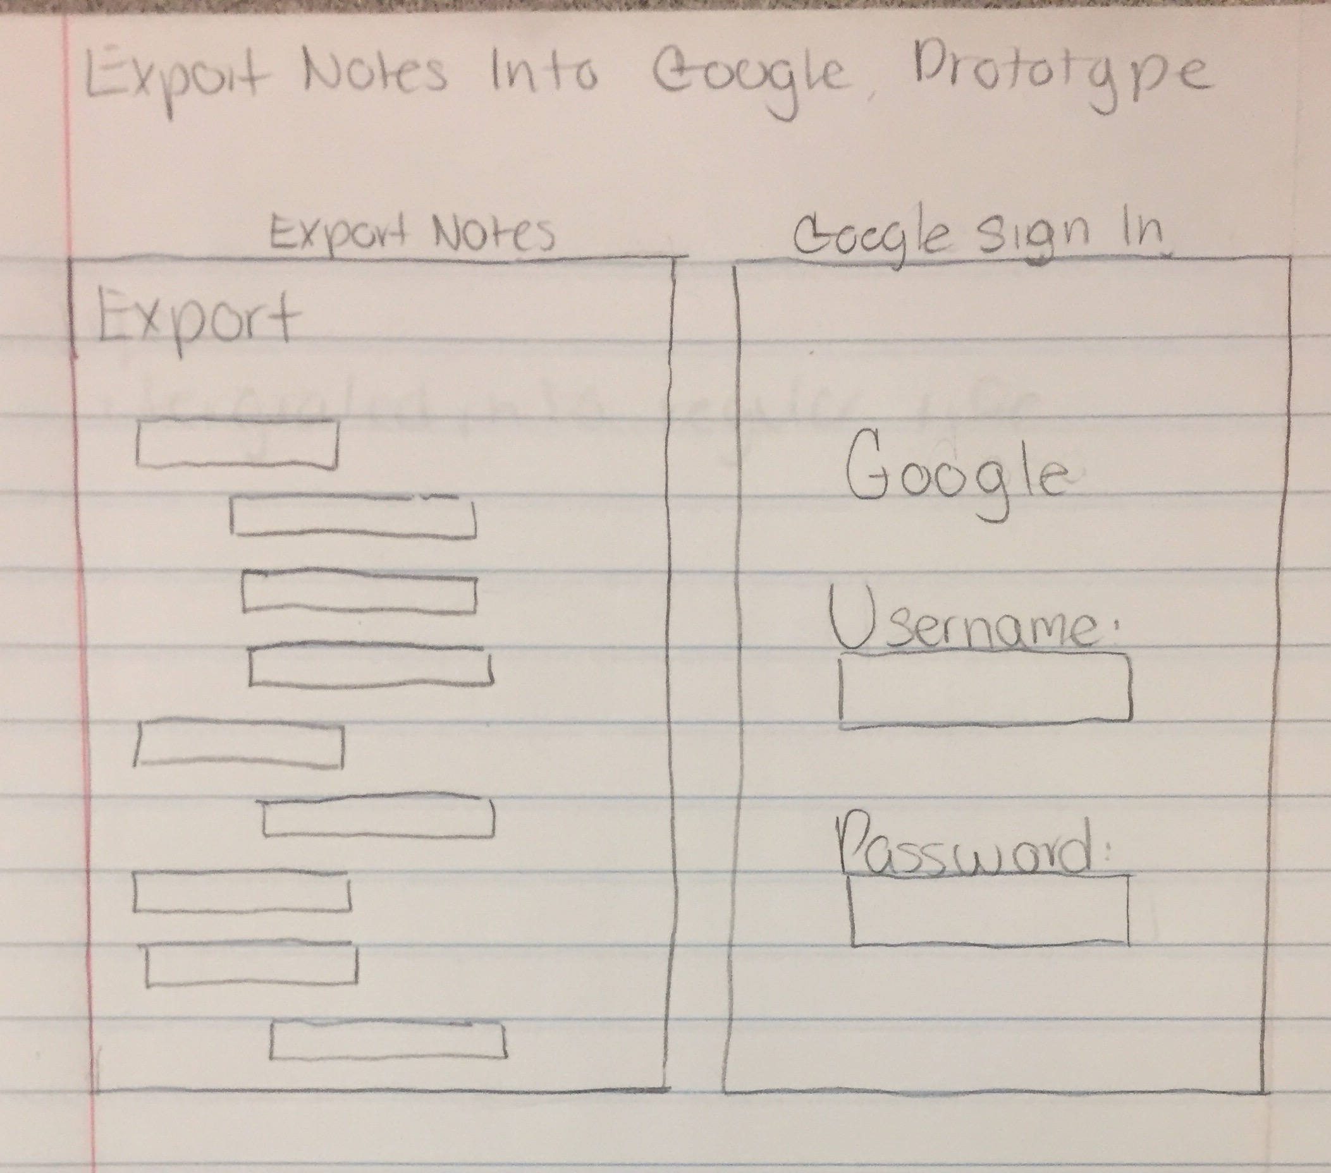
Low Fidelity Prototypes
(cont.)
Idea for exporting notes to Google (Not implemented due to constraints)

Slide 9
User Feedback from Prototype
Out of the 6 users, the average rating was about a 4.6 out of 5. It meet the user requirements nicely. Here is a list of some of the feedback:
Pros
Intuitive design
Similarities to Quizlet
Metaphor to real flashcards
Connects to Google Docs
Has word processing features
Cons
Google Docs interaction is not straightforward
Notes don’t export to Canvas
Not enough note customization (images, videos etc.)

Slide 10
Features We Decided to Skip
There were some ideas that innovative in concept. However due to several constraints, we were unable to accomplish them in the design of the site. Here are a few:
Linking words to urls
Canvas and Google Docs integration
Ability to draw notes directly into the notes section
Ability to turn notes into review quizzes
Ability to add images, videos, diagrams, tables etc into notes

Slide 11
High Fidelity Prototype Demo

Slide 12
User Feedback from High Fidelity Prototype
We haven’t been able to test this demo with all of our users due to complications in the development phase. However, we believe they will be pleased with the end result of the project. We believe this because:
We scored a 4.6/5 rating on the low fidelity prototype
We ensured the user interface was visually pleasing and easy to use
The structure of the app is similar to Quizlet
The app is robust, allowing additional features to be easily incorporated in future designs
Our app is on a live website

Slide 13
Improvements
Here are a list of improvement we think would benefit this app:
Building the app on a mobile platform rather than web platform
Adding the features that we decided to skip
Adding more branding/personality to the app
Streamlining interactions
Adding accounts

Slide 14
Summary
We determined our target users through domain knowledge
We defined requirements through user interviews.
We created a low fidelity prototype that was matched the expectation of users.
We took the user’s dislikes and suggestions into consideration and designed a high fidelity prototype that had the basic functionality that our users were looking for.
We haven’t tested on our users yet but we believe since used an iterative design methodology with a user centered design approach, we have an app that will increase test scores and college students.

